Slide 1
VARDHAMAN COLLEGE OF ENGINEERING DEPARTMENT OF CSE
Mini Project Review – II
Title: KhelQuest : AI–Powered Platform for Democratizing Sports.
Team No: H10
Guide Details
Ms. M. Sowmya
Assistant Professor
S.No | Roll No | Student Name
1 | 23881A05FK | G. SPANDANA
2 | 23881A05GJ | B. NITHIN BHARADWAJ
3 | 23881A05GL | P. BIPIN RAJ

Slide 2
Table of Contents
1. Title
2. Background Research
3. Project Planning (Include Gantt Chart)
4. Literature Survey
5. Objectives
6. Project Milestone Tracker
7. Q&A

Slide 3
KhelQuest: AI–Powered Platform for Democratizing Sports
Project Title: KhelQuest: AI–Powered Platform for Democratizing Sports.
Domain/Area: Artificial Intelligence (AI), Machine Learning (ML), Sports Analytics.
Type: Application-Based Project.
Keywords: AI in Sports, Talent Identification, Smartphone-based Analysis, Computer Vision, Cloud Analytics.

Slide 4
BACKGROUND RESEARCH
Existing Systems:
Traditional sports talent identification systems:
Depend on expensive equipment like force plates, sensors, and motion capture systems.
Require trained professionals and specialized training centers.
Are mostly available in urban areas.
Use manual evaluation, which is time-consuming and biased.
Gaps and Challenges:
Lack of equal opportunities for all athletes.
High cost of equipment and infrastructure.
Human bias in evaluation.
No real-time feedback for athletes.
Lack of secure and verified performance data.

Slide 5
Motivation of the Project:
The motivation behind KhelQuest is:
To democratize sports talent identification.
To use AI and smartphones to replace costly equipment.
To ensure transparent and unbiased evaluation.
To help athletes improve performance through instant feedback.
To support India’s vision of nurturing sports talent.

Slide 6
PROJECT PLANNING
Research Phase
Study AI in sports and computer vision techniques.
Analyze existing systems and technologies.
Review literature related to pose estimation and video analysis.
Design Phase
Design system architecture.
Select AI models and cloud platform.
Design user interface and workflow.
Implementation Phase
Develop mobile application for athletes.
Implement AI-based movement analysis.
Integrate cloud storage and dashboards.
Testing Phase
Test accuracy of AI models.
Validate performance evaluation.
Check usability on low-end devices and low connectivity.

Slide 7
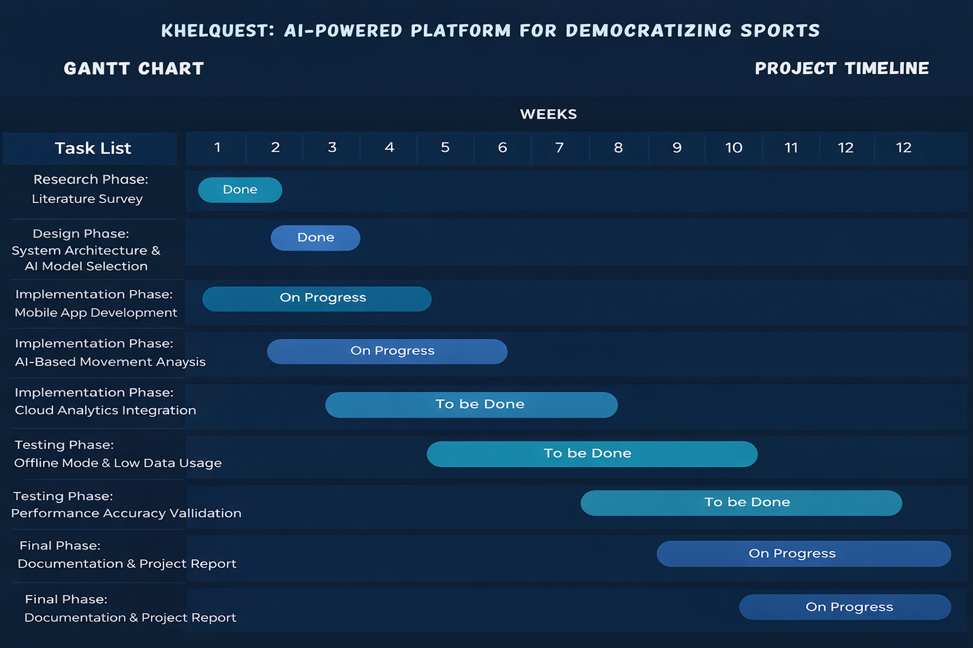
Project Planning

Slide 8
LITERATURE SURVEY
Paper Title | Approach/Algorithm | Dataset Used | Key Findings | Gaps Identified
A Review of Vision-Based Motion Analysis in Sport (Barris & Button, 2008) | Computer vision–based motion tracking using video analysis | Sports activity video recordings | Vision-based systems can analyze athlete movement without physical sensors | High computational cost; not optimized for mobile or low-resource environments
OpenPose: Realtime Multi-Person 2D Pose Estimation (Cao et al., 2019) | CNN-based pose estimation using keypoint detection | COCO Dataset, MPII Dataset | Accurate real-time pose detection for multiple users | Requires high processing power; limited mobile deployment

Slide 9
LITERATURE SURVEY
Paper Title | Approach/Algorithm | Dataset Used | Key Findings | Gaps Identified
Machine Learning Applications in Sports Performance Analysis (IEEE Xplore) | ML models for performance prediction and analysis | Sports performance datasets | ML improves objectivity and reduces human bias | Mostly focused on elite athletes and controlled environments
Analysis of Accuracy of Vertical Jump Using Low-Cost Systems (2023) | Video-based jump height estimation | Vertical jump test videos | Smartphone-based systems can reliably measure jumps | Limited scalability and no centralized data management

Slide 10
OBJECTIVES
To make sports talent identification accessible to all athletes.
To replace expensive equipment with AI-based video analysis.
To ensure fair and unbiased evaluation using AI.
To provide instant feedback to athletes for performance improvement.
To securely store athlete performance data in the cloud.
To provide analytics and dashboards for coaches and sports authorities.
To ensure the platform works in rural and low-connectivity areas.
To contribute to India’s sports ecosystem and talent development.

Slide 11
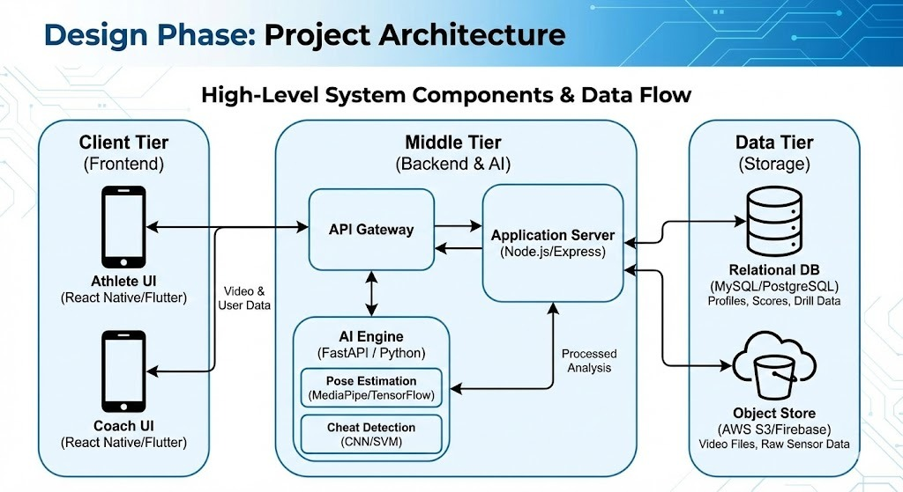

Slide 12
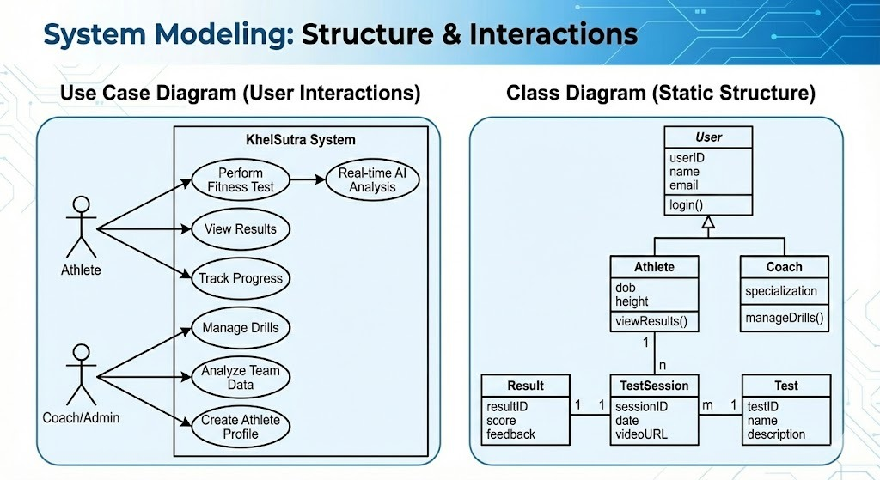

Slide 13
PROJECT MILESTONE TRACKER
Paste Scanned Copy of Handbook Page No:3(Signed)

Slide 14
Q&A

